Slide 1
Case4: Health insurance – panel analysis
Yu-Min Wang
Fall 2017
MKT 6v99

Slide 2
agenda
Executive Summary
Biz Objective
Significant Variables of MA_MAPD
Elasticity & Strategy
Test and Learn Plan
Forecast Model Validity
Financial Implication
Conclusion

Slide 3
Executive summary
Using Panel regression, I find the significant independent variables
All variables are inelastic (<1) to CNTY_MA_MAPD
Total enrolled # has the highest elasticity, 0.739
The elasticity of each ad spending is close to 0
➔ Strategy : the best way to increase MA_MAPD is to increase the enrolled #

Slide 4
Biz Objective
1
Using panel regression to build a forecast model for
Humana’s MA_MAPD change of individual (county)
over time (month)

Slide 5
Significant Variables
Adjusted R-square = 0.9999
Total CNTY_MA_MAPD : mean 5038.5, SD 10969
 | Parameter Estimates
Variable | Estimate | Pr > |t| | Means
Intercept | -320.218 | <.0001
humana_enrolled | 0.830775 | <.0001 | 4484.2
tot_competitor_enrolled | -0.02653 | <.0001 | 5549.9
zillow_housing_value | 0.001402 | <.0001 | 145760.4
humana_count_ppo_plans | -20.3662 | 0.0002 | 2.3
local_tv_spend | 0.002416 | <.0001 | 229.7
national_tv_brand_spend | 0.002681 | <.0001 | 1264.6
drtv_longform_spend | -0.00304 | <.0001 | 1882.9
digital_sem_spend | 0.007364 | <.0001 | 1338.6
dm_spend | 0.001011 | <.0001 | 2978.2
local_print_spend | 0.000858 | <.0001 | 2941.2
outdoor_ooh_spend | -0.00255 | 0.049 | 25.7
radio_spend | 0.026513 | <.0001 | 30.6
digital_sem_spend_1 | 0.001808 | 0.0029 | 1318.1
dm_spend_1 | 0.000552 | 0.0012 | 2944.5
drtv_longform_spend_1 | -0.00392 | <.0001 | 1879.8
local_print_spend_2 | 0.00081 | <.0001 | 2927.5
local_tv_spend_2 | -0.002 | <.0001 | 229.7
national_tv_brand_spend_2 | 0.004332 | <.0001 | 1261.4
radio_spend_1 | 0.080118 | <.0001 | 30.6
radio_spend_2 | 0.057476 | <.0001 | 27.8
Blue = most significant. Green : least significant

Slide 6
Elasticity
Each independent variable is inelastic about the change of MA_MAPD
Humana_enrolled has elasticity 0.739, which means if Humana’s enrolled # increases by 1%, MA _MAPD will increase by 0.739%
If total competitor enrolled # increases by 1%, Humana’s MA_MAPD will decrease by 0.029%
Each advertisement campaign has elasticity close to zero, which means the spending of ad has no impact to Humana’s CNTY_MA_MAPD
To increase MA_MAPD in each county, Humana’s most effective way is to increase the enrolled # in each county

Slide 7
Test plan
None

Slide 8
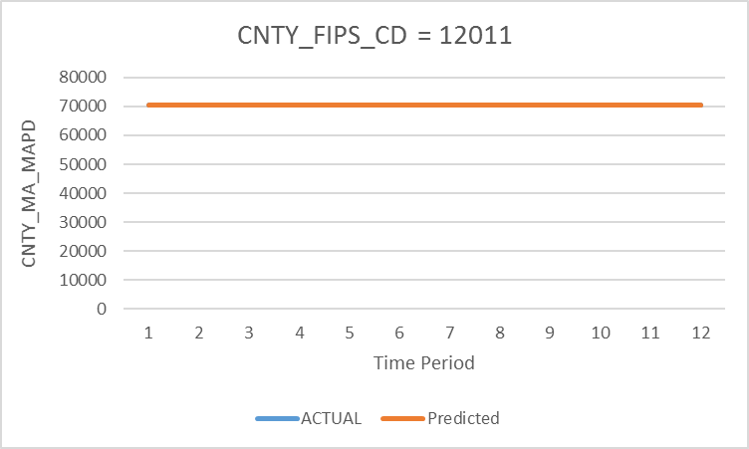
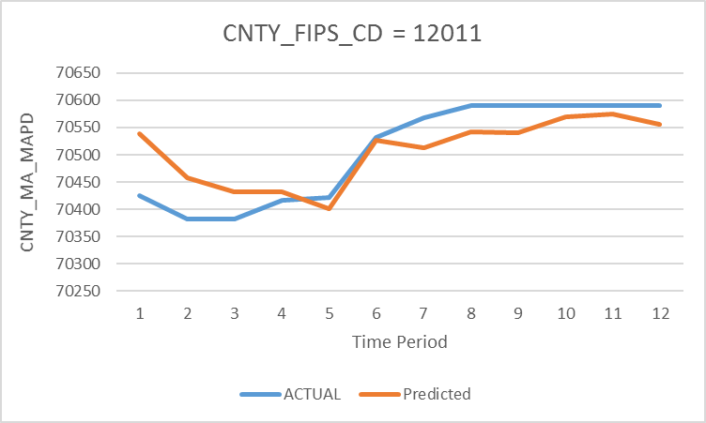
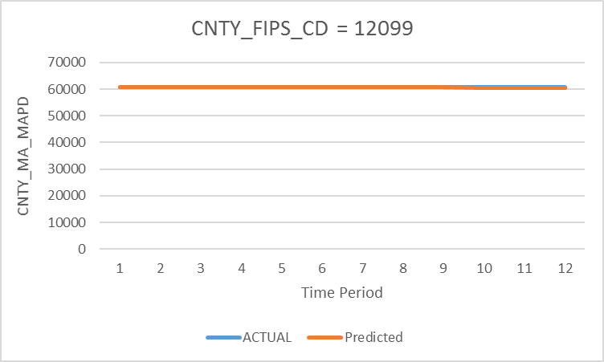
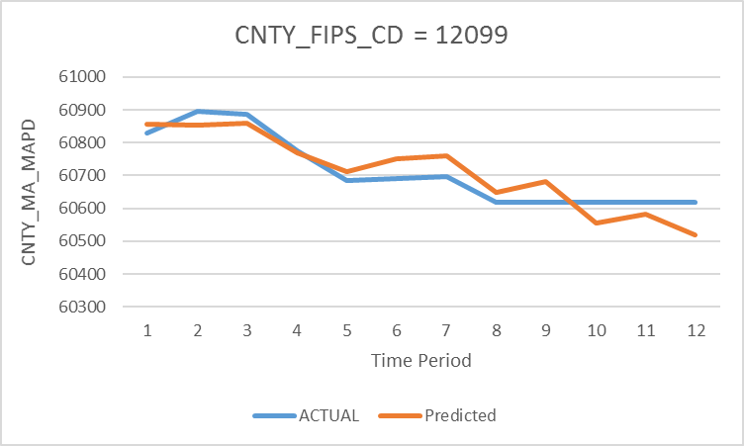
Forecast model Validity
Actual vs. Predicted for the largest 2 counties
Zoom
in
Zoom
in

Slide 9
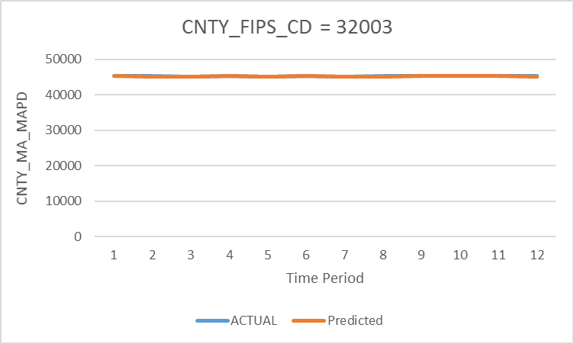
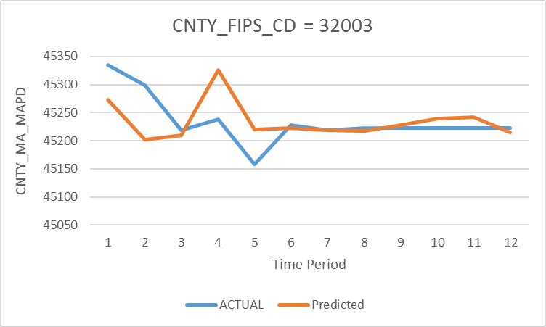
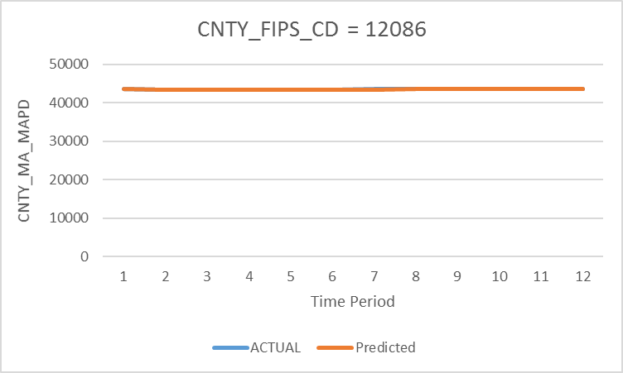
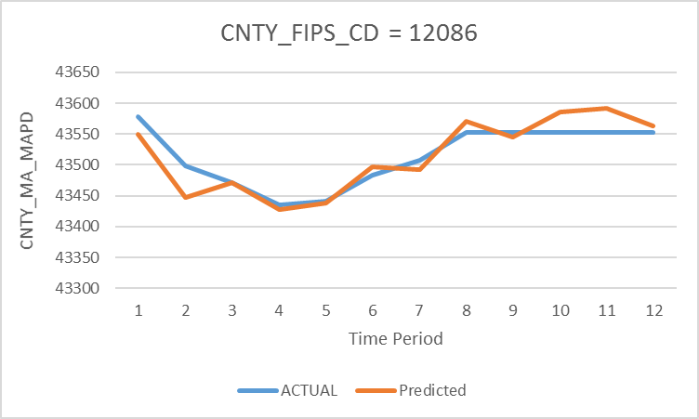
Forecast model Validity
Actual vs. Predicted for the 3rd and 4th largest counties
Zoom
in
Zoom
in

Slide 10
Financial implication
None

Slide 11
Conclusion
Panel Regression
Dependent variable = HUM_CNTY_MA_MAPD
ID = ST_CNTY_FIPS_CD, CAL_YR_MTH
Significant independent variables are all inelastic to MA_MAPD
Humana enrolled, ε = 0.739
Total competitor enrolled, ε = 0.029 (negative)
Zillow housing value, ε = 0.041
All the ad spending variables have elasticity close to 0
Spending on ad can not increase MA_MAPD
The most effective way is to increase Humana enrolled #

